Slide 1
Visual Analytics for Topic Model Optimization based on User-Steerable Speculative Execution
By,
Mennatallah El-Assady, Fabian Sperrle, Oliver Deussen, Daniel Keim, and Christopher Collins
In IEEE TRANSACTIONS ON VISUALIZATION AND COMPUTER GRAPHICS
Reference to this paper:
M. El-Assady, F. Sperrle, O. Deussen, D. Keim and C. Collins, "Visual Analytics for Topic Model Optimization based on User-Steerable Speculative Execution," in IEEE Transactions on Visualization and Computer Graphics, vol. 25, no. 1, pp. 374-384, Jan. 2019, doi: 10.1109/TVCG.2018.2864769.
https://kops.uni-konstanz.de/bitstream/handle/123456789/43555/El-Assady_2-1cwc6z3rv48981.pdf;jsessionid=5C8209322AE2A22874CD774246CCD18A?sequence=1

Slide 2
What is the problem ?
We mainly use a topic modelling algorithm for segmentation of a collection of documents into groups.
But the model is considered as a black box.
So leads to lack in trustworthiness in the model.

Slide 3
What is the research goal?
To avoid the problems faced by humans in an model analytics system, we establish a concept of speculative execution.
In this paper presents an explainable, mixed-initiative topic modeling framework that integrates speculative execution into the algorithmic decision making process.

Slide 4
Human-In-The-Loop Process
Users are allowed to interact with the model and make changes to the model.
This supervised human-in-the-loop process targets maximum improvement for minimum feedback.
This has been proven to be effective in topic model quality improvements.

Slide 5
A deeper dive into the problem!
Solutions that are existing is a one-way approach.
It is notoriously difficult to get an intuition of the effect of changing algorithmic parameters or directly manipulating the model-space on the output of these models
Parameter space is the space of possible parameter values that define a particular mathematical model and model space is where an user work(Eg:workbench).
This causes difficulty in visualization since there is a discontinuity between the parameter space and the model space.

Slide 6
What methods are being applied?
In order to provide a continuous transparency to a visual analytic system we need a explainable and visualizable topic modelling approach.
We apply an approach called Incremental Hierarchical Topic Modelling(IHTM) and Speculative Execution.
These above methods are a mixed initiative approach which is nothing but an interaction between the human and the computer.

Slide 7
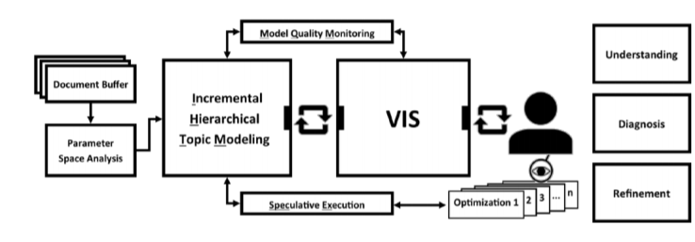
Working of the methods proposed

Slide 8
Evaluation Factors
The factors that are used to evaluate the working of the proposed methods are,
Topic model understanding,
Model quality monitoring,
Topic tree refinement.

Slide 9
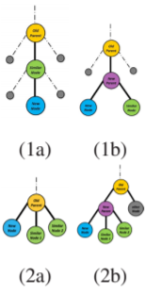
Incremental Hierarchical Topic Modelling
The similarity is found between documents each when it is being inserted.
We rely on Monotonicity property similarity function.
It is defined as : ∀d, p, c ⊆ T
This guarantees that the similarity cannot increase when going from leaf
nodes to the root, making each parent node in the tree more general
than its child.

Slide 10
IHTM as a Explainable topic model
This model is designed to be an explainable topic modeling approach.
Thus support all their suggested update and refinement operations,
including adding,
removing, and changing keywords;
moving documents within the topic hierarchy and lastly,
Splitting, merging, removing, and creating topics

Slide 11
Advantages of IHTM
Thus, it is tightly coupled with the visual analytics system.
The main advantage of IHTM is that it does not require the specification of number of topics to before the starting the process.

Slide 12
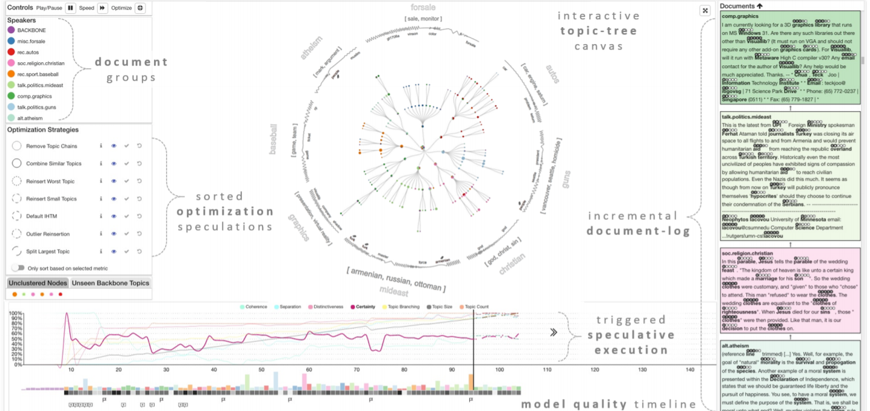
The Visual analytic workplace

Slide 13
Modes of operation
There are mainly two modes of operation in the visual analytic workspace. They are,
Operation mode - running, updating one model.
Speculation mode - the IHTM is waiting for the user’s feedback

Slide 14
Interactive design
The window is highly interactive that has 3 coordinated views in the workplace,
In the document log
In the topic tree
In the timeline.

Slide 15
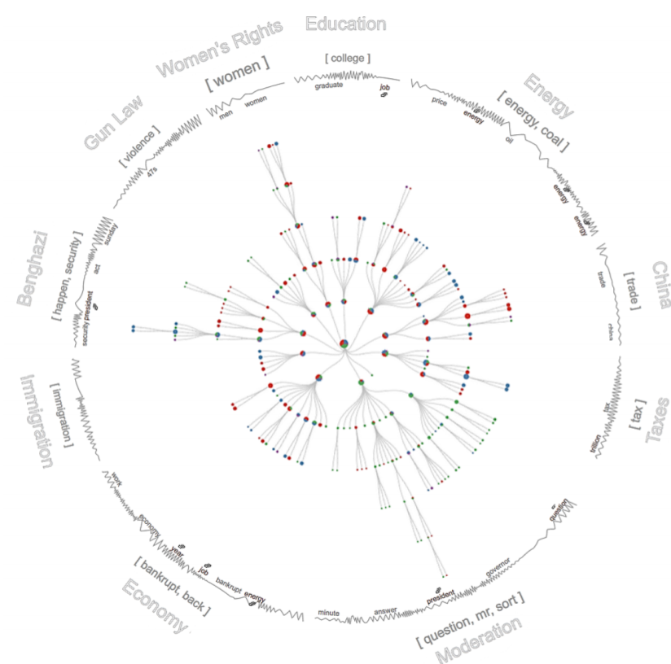
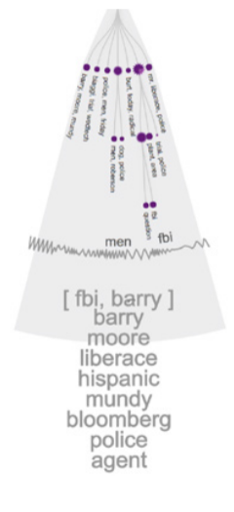
Topic-tree visualization

Slide 16
Speculative Execution
This method is used in software engineering and process optimization.
There are two functionalities they are,
SpecEx Preview and
Temporal-speculation, which shows the further development of topic trees

Slide 17
Automatic optimization
Framework implements six optimization strategies. These have been developed based on observations of manual optimization intentions.
Combine Similar Topics
Reinsert Worst Topics
Reinsert small Topics
Outlier Reinsertion
Split Largest Topic
Remove Topic Chains

Slide 18
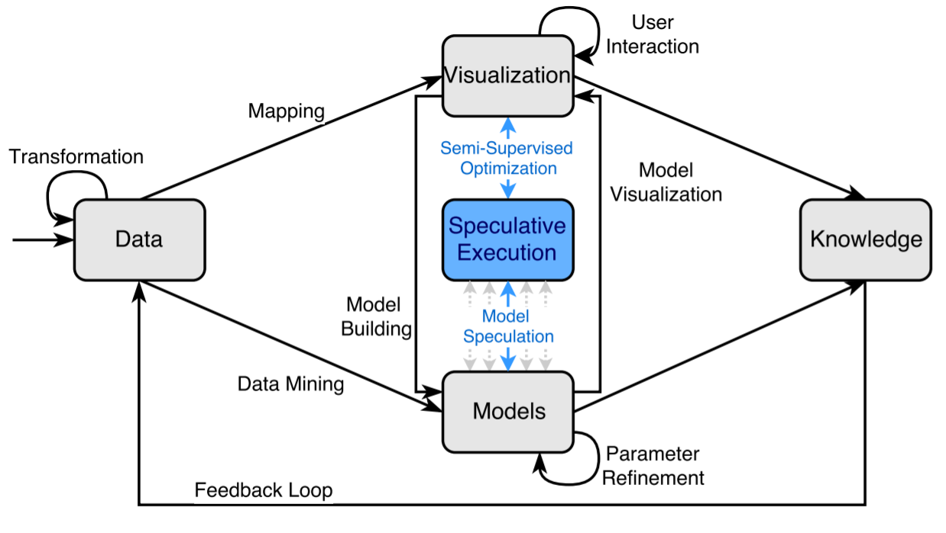
Speculative execution as semi-supervised optimization technique

Slide 19
SpecEx as a Visual analytics technique
Speculation is possible across a number of different analytic options, such as
Different algorithms,
Temporal predictions on streaming data,
Alternative parameter settings, or multiple runs of non-deterministic algorithms

Slide 20
Evaluation
Evaluated the proposed techniques with three different approaches involving 13 participants over 40 hours.
IHTM vs Probabilistic models
Experts feedback.
Model quality assessment.

Slide 21
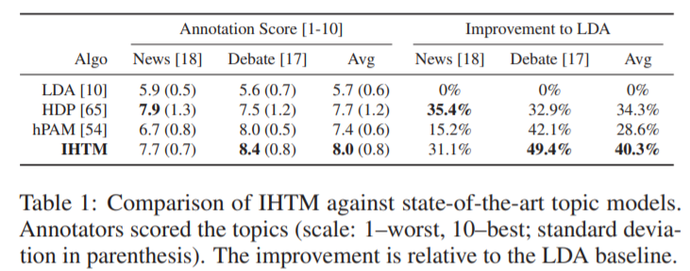
Expert Feedback

Slide 22
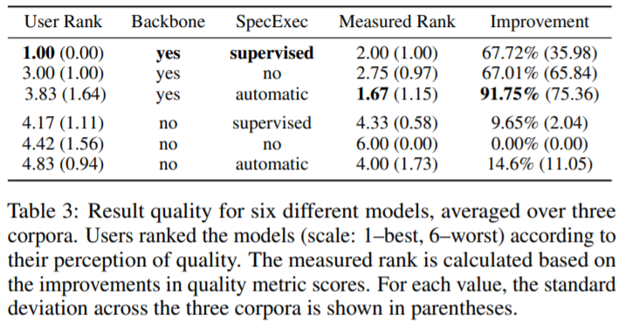
Model quality assesment

Slide 23
Conclusion
A visual analytics framework for mixed-initiative topic model optimization.
A tailored visual analytics workspace that interactively displays all intermediate results of the topic modeling, allowing users to understand and refine them.
For a targeted optimization, Speculative Execution is established.
Outperformed all the other three models.

Slide 24
Future Work
Transferring the concept of speculative execution in visual analytics to other problem domains.
To examine other potential model-space visualizations to foster further understanding of machine learning processes.
For a better user-guidance, we would study which measures best capture the human intuition.

Slide 25
Thank you !!!

